Slide 1
Javascript Fundamentals
.JS
Semicolons for days.

Slide 2

JavaScript runs in the browser
In 1995, Brendan Eich developed JavaScript, and embedded it in Netscape Navigator, the most popular browser in the world.
Notes:
We didn’t choose Javascript; Javascript was chosen for us. Alongside HTML and CSS, it is one of the three core technologies of web content; the majority of websites employ it, and it is supported by all modern Web browsers without plug-ins.

Slide 3

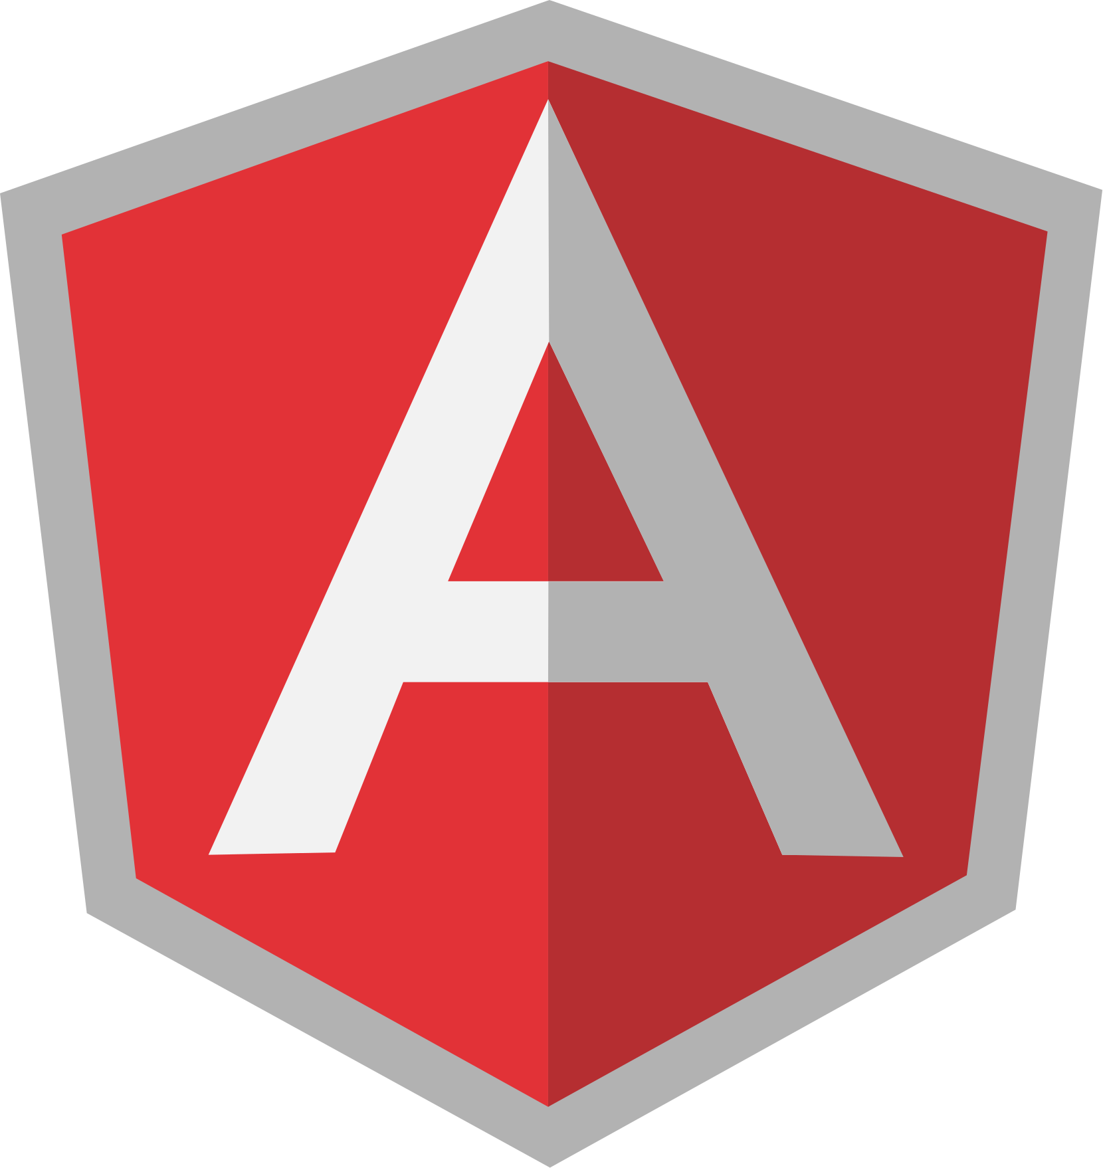



Frameworks
So many frameworks...
Notes:
Such frameworks. Very wow. (You too will learn to suffer from framework fatigue.)

Slide 4
JS is:
High-level
Interpreted / Dynamically-Compiled
Loosely-typed
Notes:
For some computer languages, this translation of commands is typically done from top to bottom, line by line, every time the program is run, which is usually called interpreting the code.
For other languages, the translation is done ahead of time, called compiling the code, so when the program runs later, what's running is actually the already compiled computer instructions ready to go.
It's typically asserted that JavaScript is interpreted, because your JavaScript source code is processed each time it's run. But that's not entirely accurate. The JavaScript engine actually compiles the program on the fly and then immediately runs the compiled code.

Slide 5
Run JS...
In your Chrome browser:
  Press Ctrl + Shift + J (Windows / Linux)
  Press Cmd + Opt + J (Mac)
Embedded in a webpage:
  Use the <script> tag
Notes:
Don’t delve too deeply here; we will go into more (and salient) detail in subsequent slides.

Slide 6
2 main ways to use the <script> tag
Embedding JavaScript directly in the HTML by writing code between the opening and closing <script> tags:
<script>
alert(“This is JavaScript code!”)
<script>
Referencing an external file containing the JavaScript source (preferred)
<script src=”my_javascript_file.js”></script>
Notes:
Don’t delve too deeply here; we will go into more (and salient) detail in subsequent slides.

Slide 7
<html>
<head>
<meta charset="utf-8">
<title>My Wicked Awesome Website</title>
<!-- load any JavaScript needed to initially render the page or -->
<script src="js_necessary_for_rendering_page.js"></script>
<script src="js_that_adds_functionality_to_older_browsers.js"></script>
</head>
<body>
<!-- contents of the web page go here -->
<!-- load all other JavaScript once the page has been loaded -->
<script src="all_other_js.js"></script>
</body>
</html>
Notes:
Don’t delve too deeply here; we will go into more (and salient) detail in subsequent slides.

Slide 8
Types.js

Slide 9
Seven Data Types
String
Number
Boolean
Null
Undefined
Symbol*
Object
Symbol is new in
ECMAScript 6.
There is only one Number type.
JS provides a typeof( ) function

Slide 10
Objects
In Ruby “everything is an object”
In JS, MOST things are objects
  Ex. functions are subtypes of objects
  Object refers to values that are like hashes where there are key-value pairs
  those values can even be functions (aka methods)

Slide 11
Let’s Get Object-Oriented
In JavaScript, this syntax of object definition is called the Object Literal.
You may notice it looks a little bit like a Ruby Hash.
ES6 has made objects richer (ex for we can actually omit function keyword)
let sortingHat = {
age: 1023,
material: "leather",
singSong: function() {
return “You're in safe hands (though I have none), for I'm a Thinking Cap!”;
}
}

Slide 12
Variables.js
let foo = “bar”;

Slide 13
Declaring Variables
let a = 1;
let foo = “foo”;
let tastyBurger = true;
The let keyword is used to declare a variable in the current scope.

Slide 14
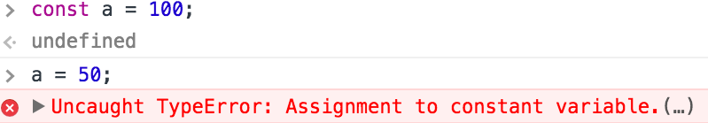
const
Similar to let, but the variable identifier can’t be reassigned

Slide 15
Functions Are Everything
function halve(number) {
return number / 2;
};
Can use the function keyword to define a function, then place brackets around the code that runs when you call it.
You must call the return keyword in order to have a return value.

Slide 16
Functions
let adder = function(a , b) {
console.log(a + b);
}
adder(1, 2); // 3
Organizes code
Keeps things DRY
Can be assigned to a variable
Can be passed around as arguments

Slide 17
Javascript is...
SCRAPPY

Slide 18
Equality
“Loose” vs. “strict” equality, COERCION

Slide 19
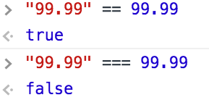
Implicit coercion
What’s happening here? We are comparing the string, “99.99” and the number, 99.99
With ==, you allow JavaScript to use “coercion”, aka it will try and convert, in this example, the left hand side to a Number data type and THEN compare
=== does not allow for coercion
Using == is a little like talking to a person, they sort of assume what you were trying to do
“99.99” vs. 99.99

Slide 20
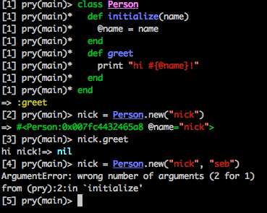
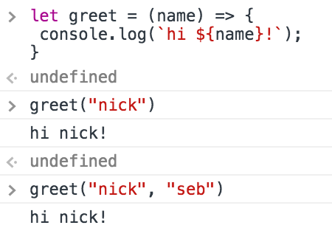
It just kind of tries to do stuff…
Notes:
For example it does not give you “wrong number of argument” errors...

Slide 21
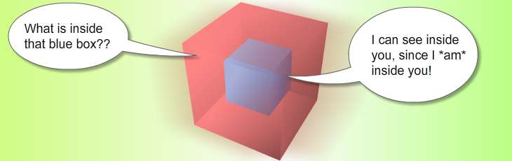
Scope
Scope is basically a collection of variables as well as the rules for how those variables are accessed by name

Slide 22
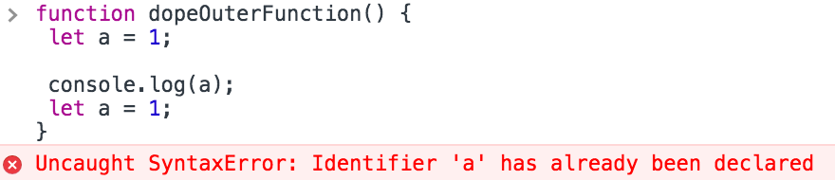
Scopey scope scope
A variable name has to be unique within the same scope, if you need to refer to it simply drop the let

Slide 23
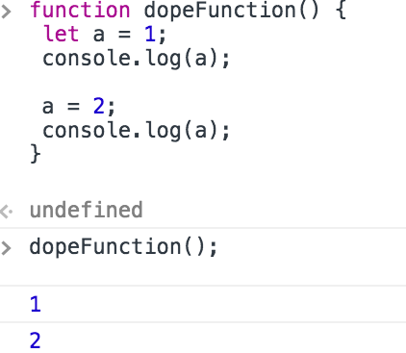
Scopey scope scope
To reassign a variable in the same or an inner scope, simply drop the let keyword.

Slide 24
Scopey scope scope
Lexical scope rules say the code in one scope can access variables of either that scope or any scope outside of it
function outer() {
let a = 1;
function inner() { // inner function has access to a and b
let b = 2;
console.log(a + b); // 3
}
// outer function is only aware of a
inner();
console.log(a);
console.log(b); // leads to reference error
}

Slide 25
Arrays.js
This you’ll recognize. Sort of.

Slide 26
Define Your Array
let trio = [“Harry”, “Ron”, “Hermione”];
Defining an array works about like you would expect, using JavaScript syntax which we have already touched upon.

Slide 27
Manipulate Your Array
let trio = [“Harry”, “Ron”, “Hermione”];
for (let i = 0; i < trio.length; i++) {
sortIntoGryffindor(trio[i]);
}
Looping over an Array works a little differently

Slide 28
Debugging.js
Finding out how to fix it.

Slide 29
Three Tools For Success
alert(“Help!”)
When your code gets to a line with an alert function, a dialog window will pop up.
Helpful to see if/when code is being called.
console.log(“No!”)
This function outputs a message to the web console.
Similar to a puts statement in Ruby.
debugger
This keyword creates a breakpoint in the web CONSOLE (in some browsers.)
A lot like using binding.pry in Ruby.

